Slide 1
Logistic Regression

Slide 2
Logistic Regression
We are basically trying to find the relationship between a dependent variable and one or more independent variable
Predictive analysis: Used to model the probability of a certain event
Pass/Fail
Yes/No
Spam/Non spam
Uses Logistic Function to model binary dependent variable
Dependent variable should be categorical in nature
Independent variable can either be categorical or continuous

Slide 3
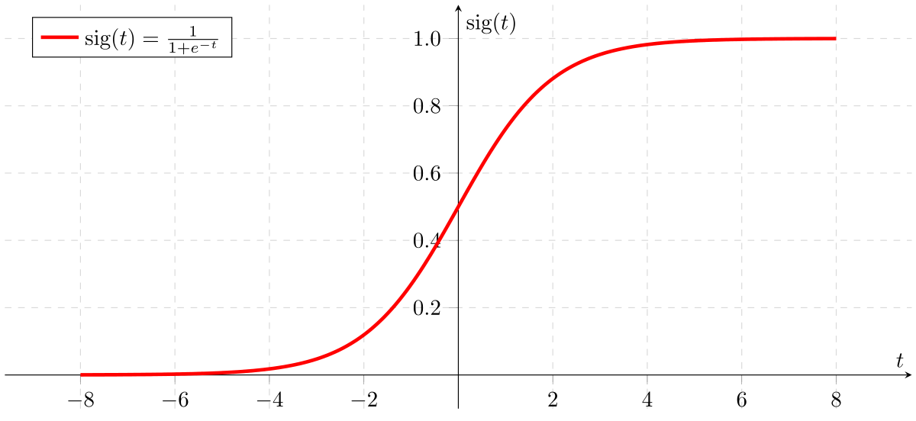
Sigmoid Function
The output from the hypothesis is the estimated probability. This is used to infer how confident can predicted value be actual value when given an input X.

Slide 4
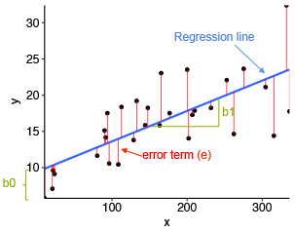
Difference with linear regression

Slide 5
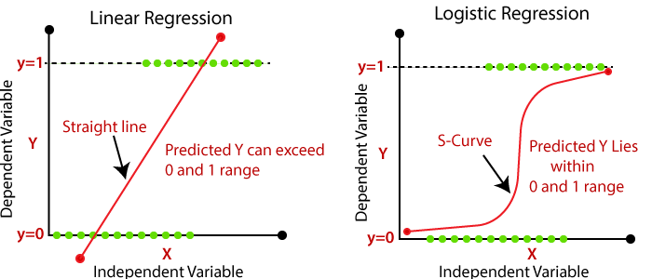
Difference between Linear and Logistic
In linear regression our dependent variable might go above 1 or below 0. However we need a function which always returns a value between 0 and 1 for whatever values of the independent variables.

Slide 6
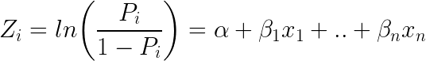
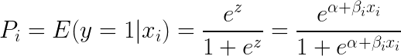
Logistic Regression
Derivation of sigmoid function :
Taking exponent on both sides of the equation gives:

Slide 7



Logistic Regression
Decision Boundary:
Setting a threshold
Helps in classifying into a class
Hypothesis function for linear
Hypothesis function for Logistic
g(z) is the logistic function also known as sigmoid function

Slide 8

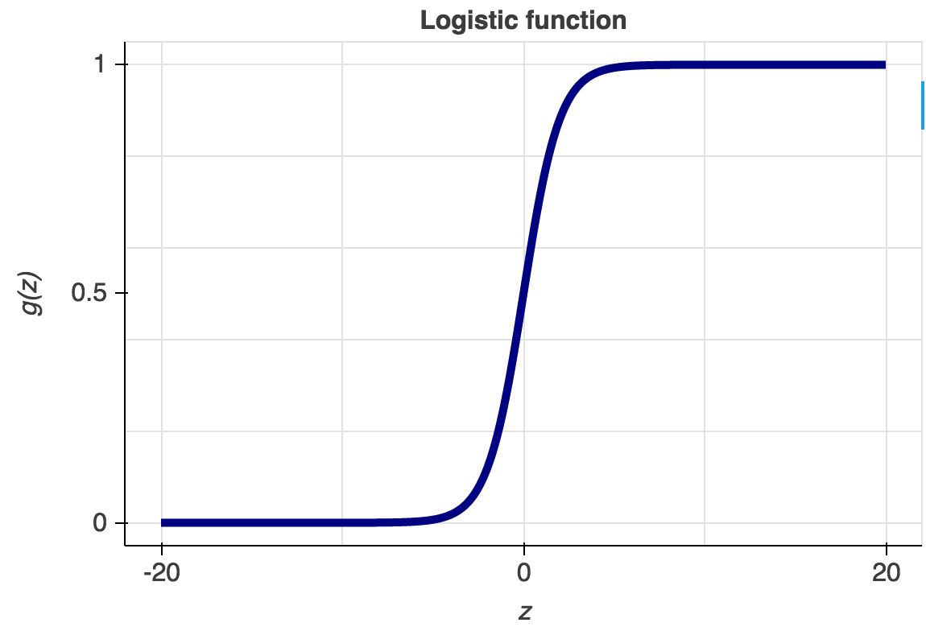
Logistic Regression
For a two independent variable system the hypothesis unction will look like

Slide 9

Logistic Regression
After putting this value y into the logistic function we will ge a value between 0 and 1

Slide 10



Logistic Regression
Cost function
We have to minimise this cost function:

Slide 11


Logistic Regression
To minimise this cost function there exists many algorithms
The most common of them being gradient descent and newton’s method
Partial derivative of the logistic regression cost function.
Prototype of gradient descent

Slide 12
Thank You

